Slide 1
Mean Shift
Clustering Algorithm

Slide 2
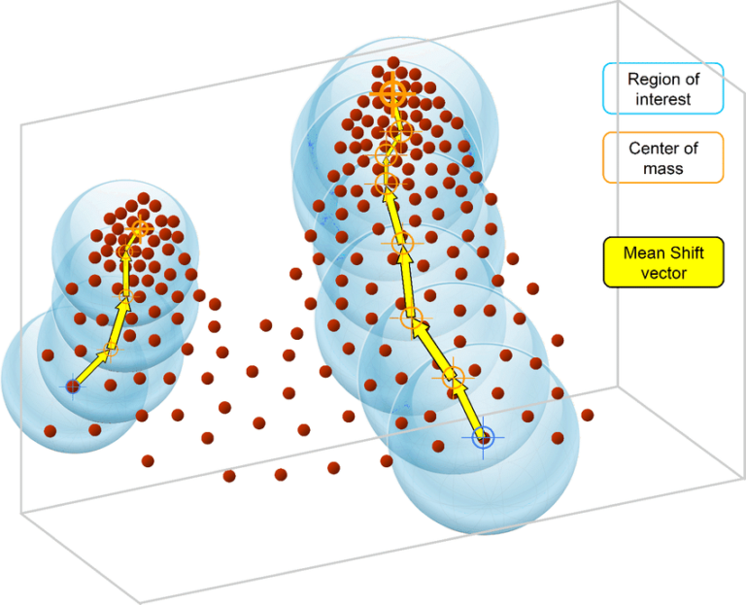
Iteratively moves data points towards the mode of their nearest neighborhood based on a kernel density estimation.

Slide 3
Best for
Detecting arbitrary-shaped clusters..
A shape that can be represented without specific parameters, which allows for flexibility and the ability to support the changes during deformation.

Slide 4
Strengths
Weaknesses
Strengths Can find the number of clusters automatically
Computationally expensive, especially for large datasets.

Slide 5
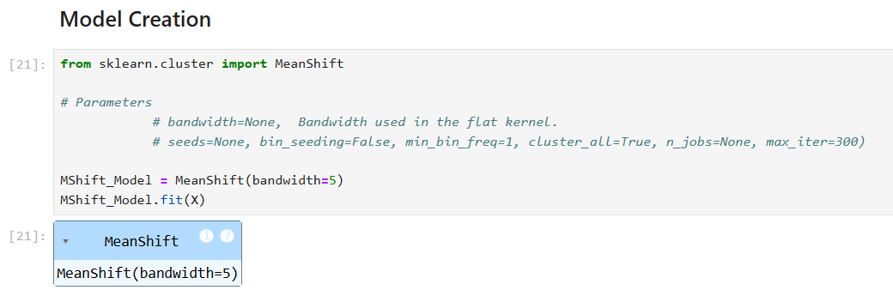
Model Creation

Slide 6
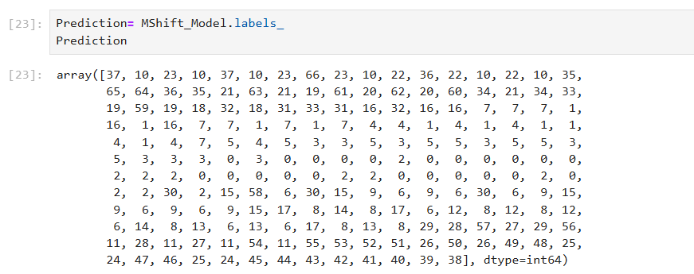
Prediction

Slide 7
Priyadharshini Manikandan

